Slide 1
Deep Learning for Econometrics
Greg Lewis (MSR + NBER) Matt Taddy (MSR + Chicago)
Jason Hartford (UBC) Kevin Leyton-Brown (UBC)
Kui Tang (Columbia) Dave Blei (Columbia)
Matt Goldman (MSFT) Justin Rao (MSR) Di Wang (MSFT)
James Zou (Stanford) Mengting Wan (UCSD) Richard Li (UW)

Slide 2
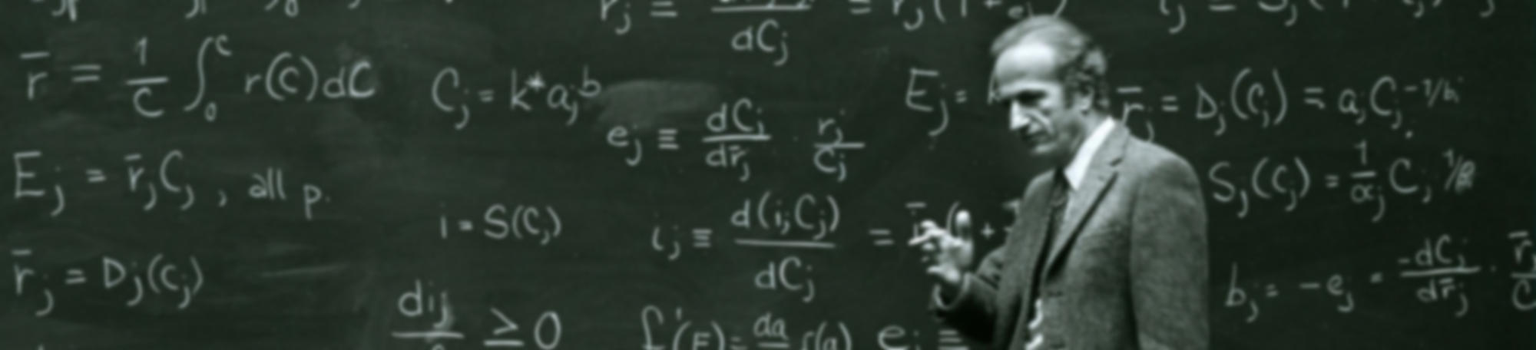
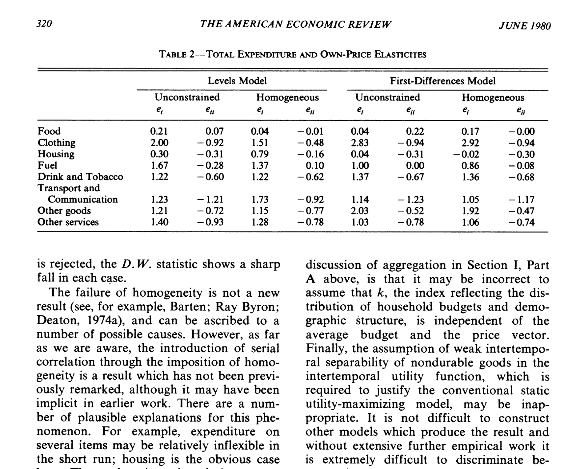
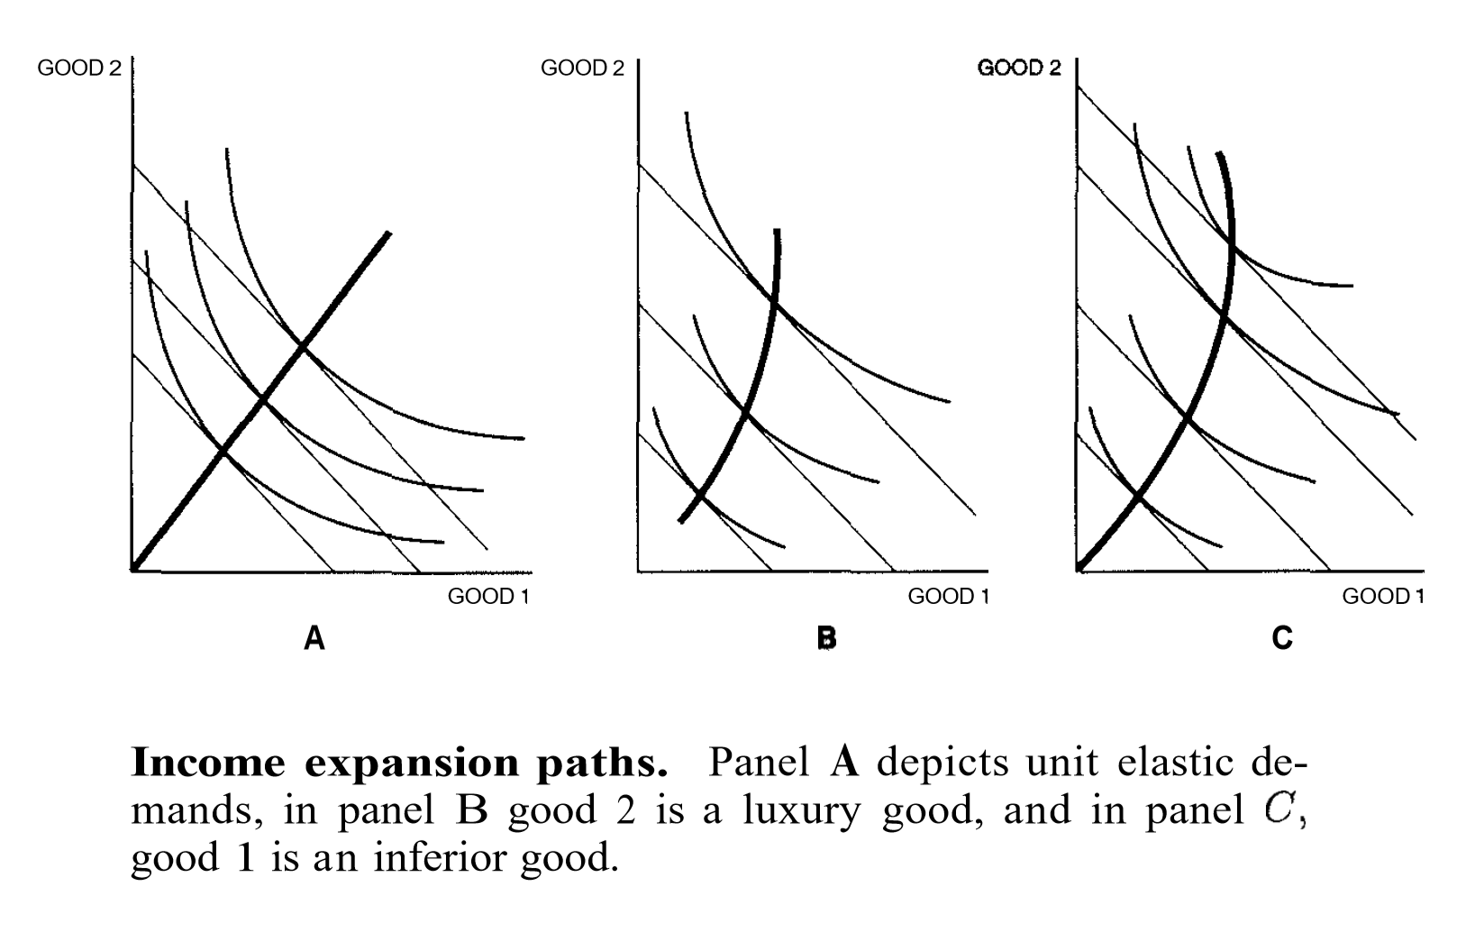
What do economists do?

Slide 3
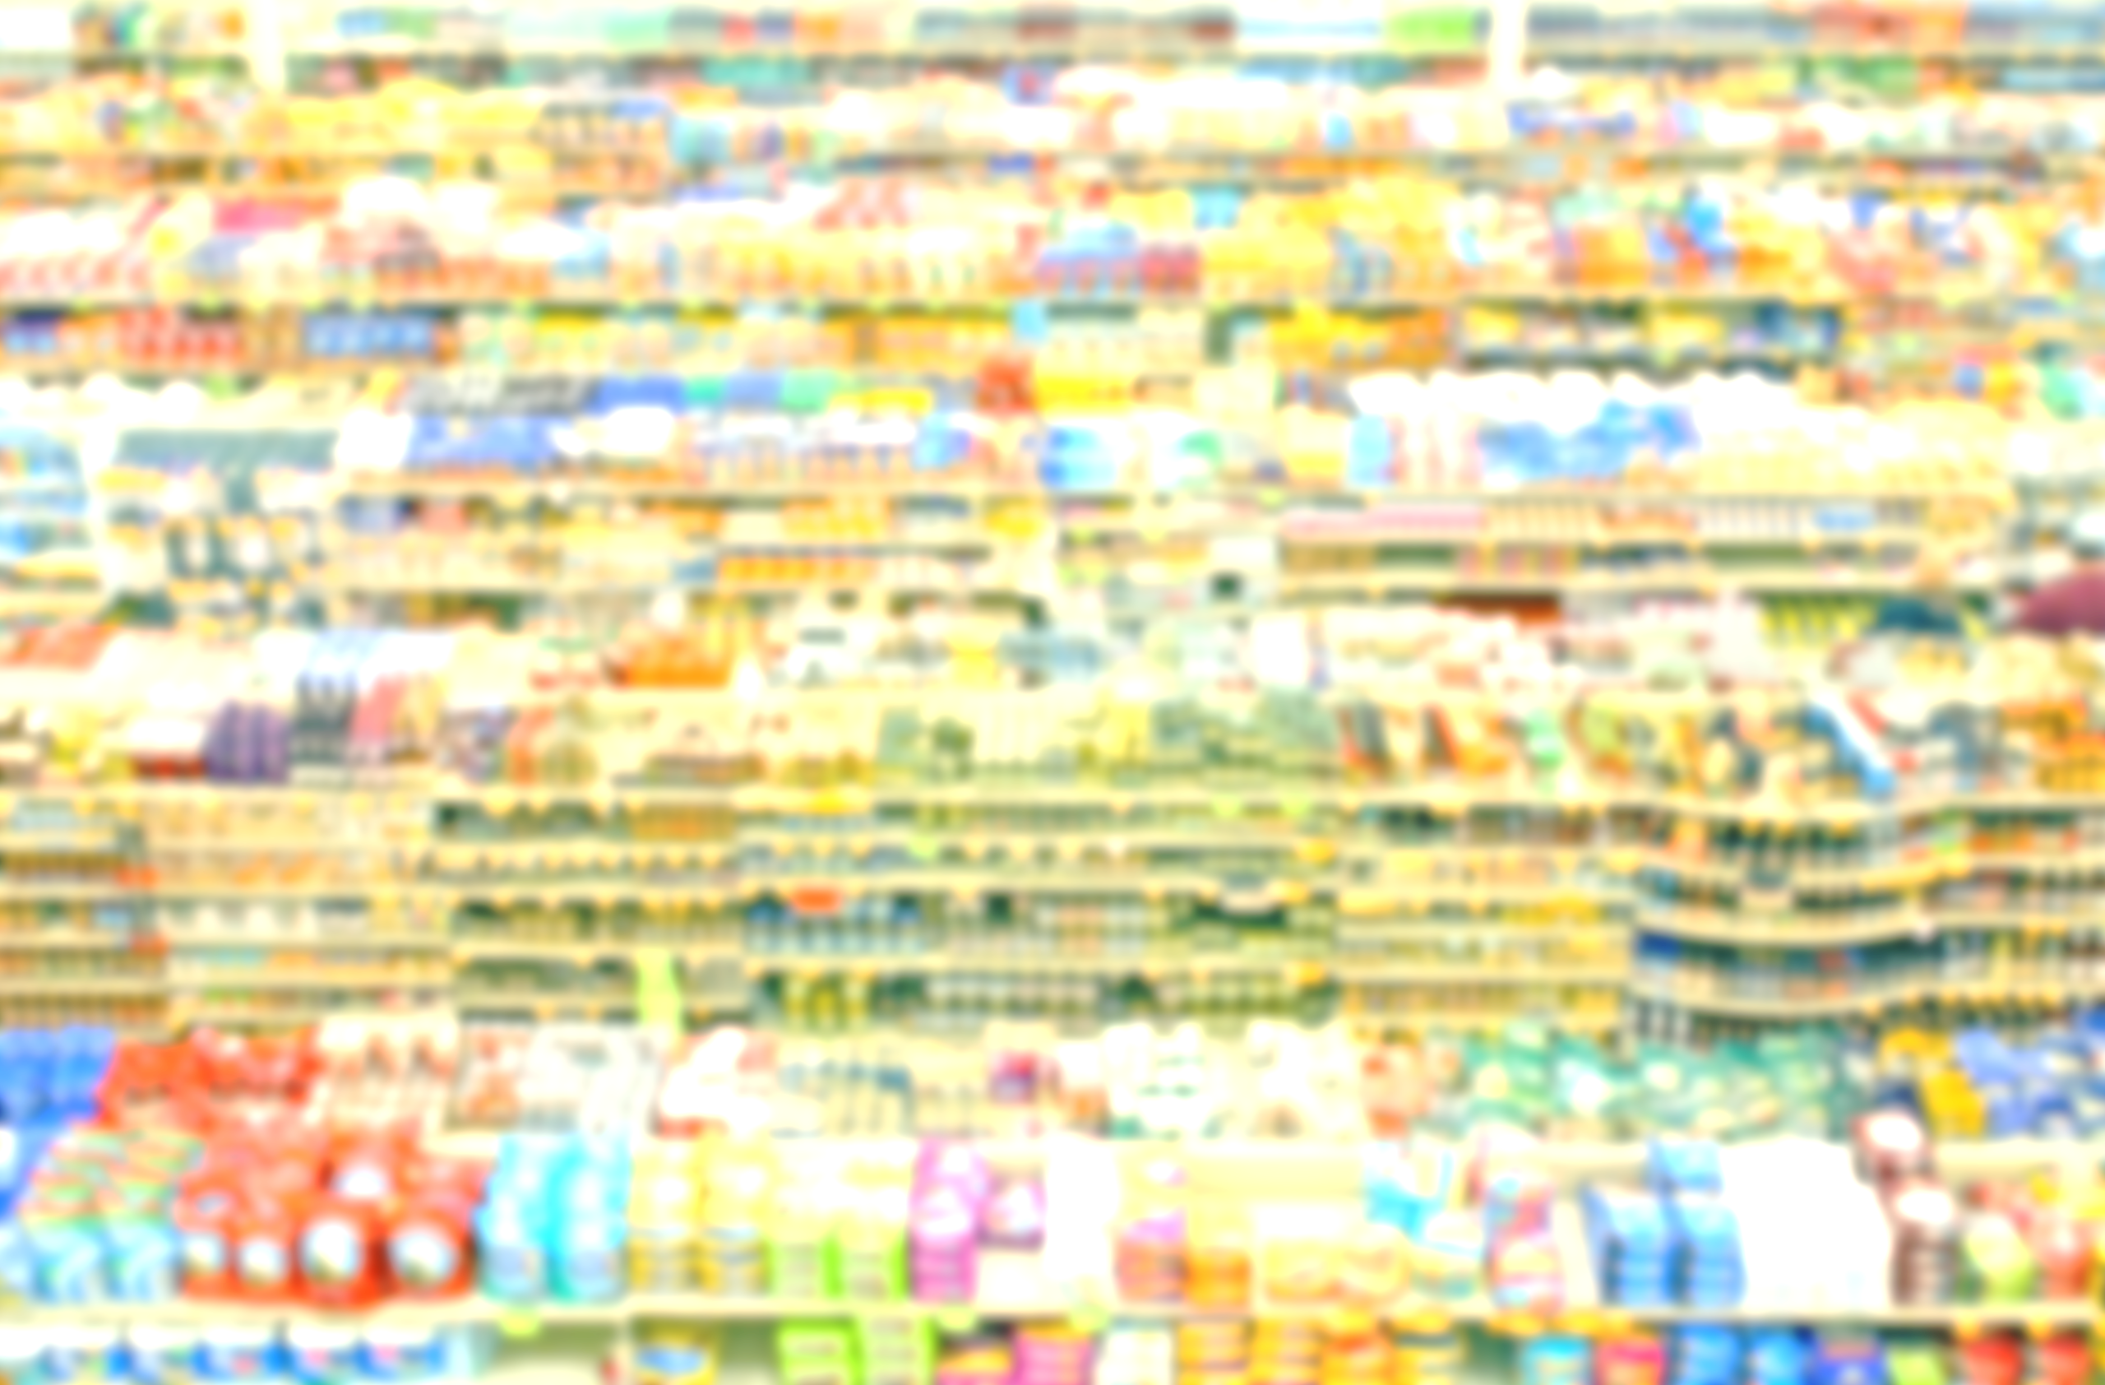
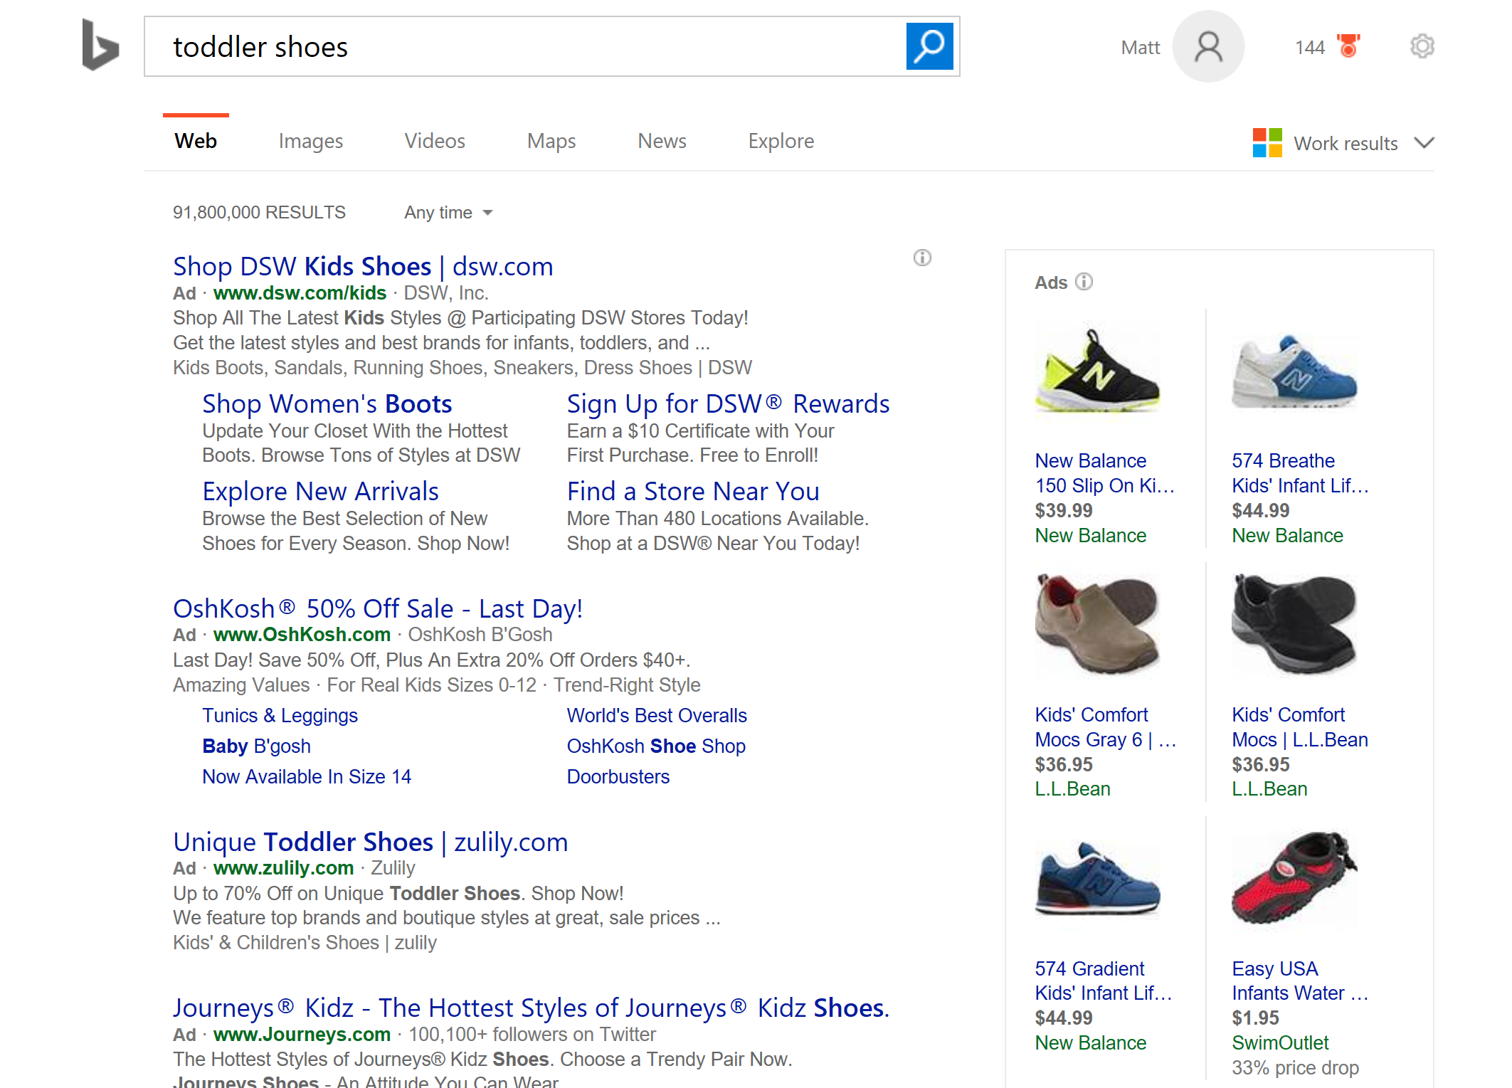

What do they need to do today?

Slide 4
What can we (AI) do to help?
The dimension of the economist’s problem space has exploded
We can develop ML to navigate this space: stay safe and automate
We can also build new econometrics via deep structure

Slide 5
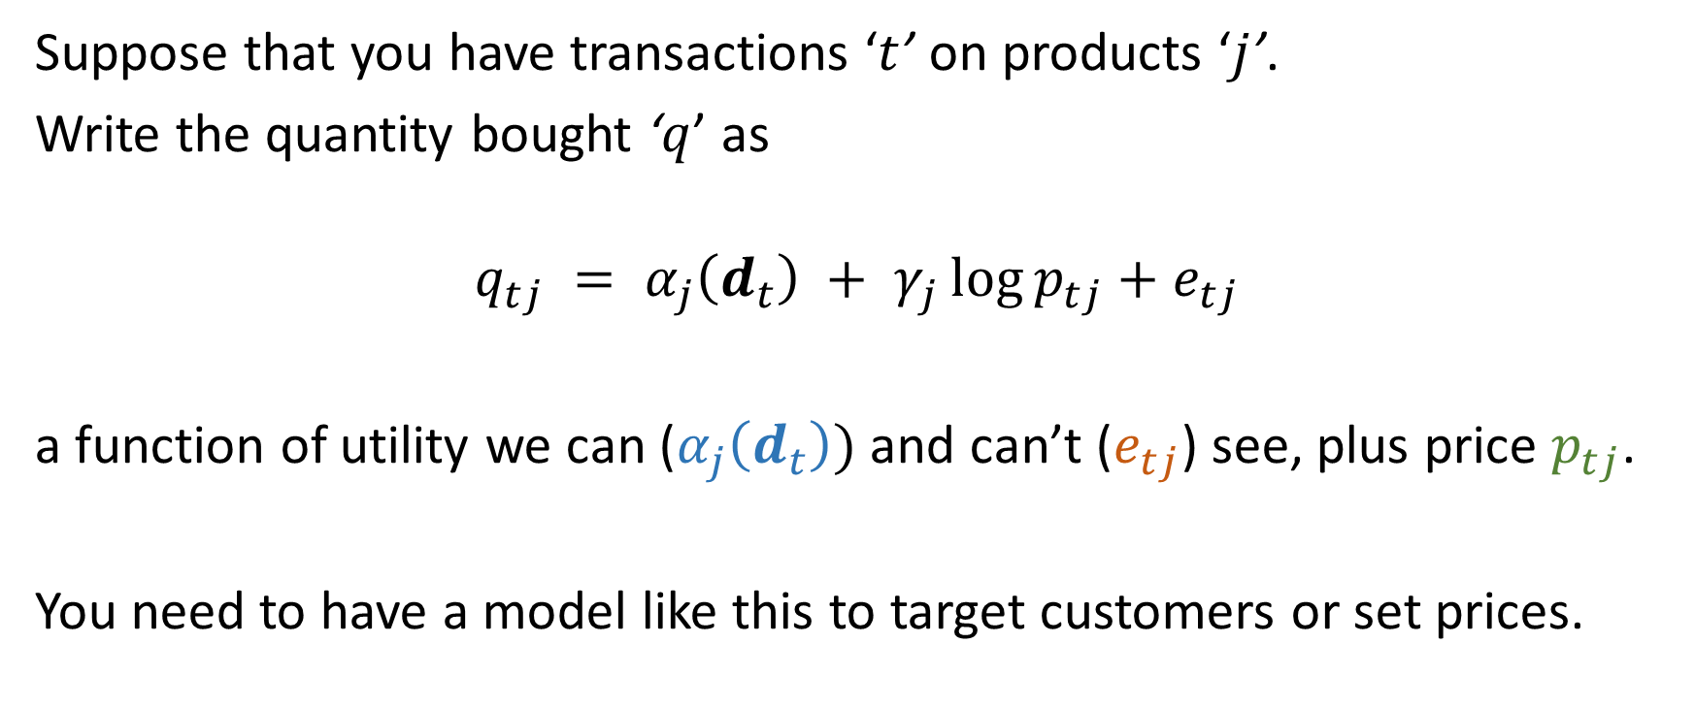
Example: Demand System
Suppose that you have transactions ‘$t$’ on products ‘$j$’.
Write the quantity bought ‘$q$’ as
$$q_{tj} = α_{j}\left(d_{t}\right) + γ_{j}\log{p_{tj}}+e_{tj}$$
a function of utility we can ($α_{j}\left(d_{t}\right))$ and can’t ($e_{tj}$) see, plus price $p_{tj}$.
You need to have a model like this to target customers or set prices.

Slide 6
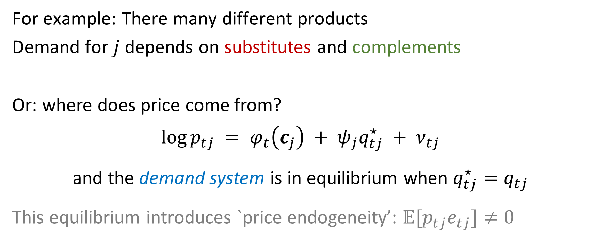
But it’s a system!
For example: There many different products
Demand for $j$ depends on substitutes and complements
Or: where does price come from?
$$\log{p_{tj}} = φ_{t}\left(c_{j}\right) + ψ_{j}q_{tj}^{⋆} + ν_{tj}$$
and the demand system is in equilibrium when $q_{tj}^{⋆}=q_{tj}$
This equilibrium introduces `price endogeneity’: $𝔼[p_{tj}e_{tj}]≠0$

Slide 7
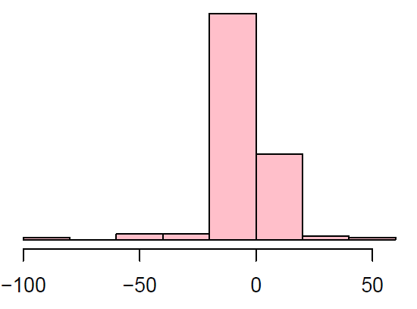
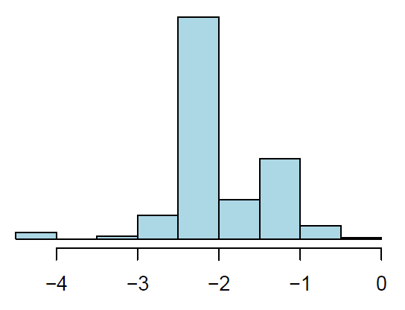

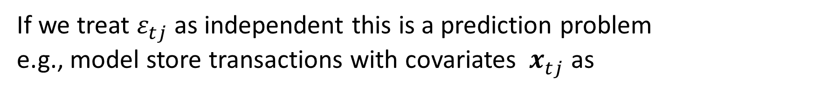
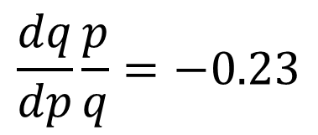
Sometimes it’s just regression
If we treat $ε_{tj}$ as independent this is a prediction problem
e.g., model store transactions with covariates ${ x}_{tj}^{ }$ as
$$𝔼\log{q_{tj}} ={ x}_{tj}^{′}β +\log{p_{tj}}x_{tj}^{′}γ$$
Elasticities:
one shared: $x_{tj}=1$ brand-specific: $x_{tjk}= 𝟙_{\left[k=j\right]}$ $x_{tj}^{ }$= featurized description
$$\frac{dq}{dp}\frac{p}{q}=−0.23$$

Slide 8
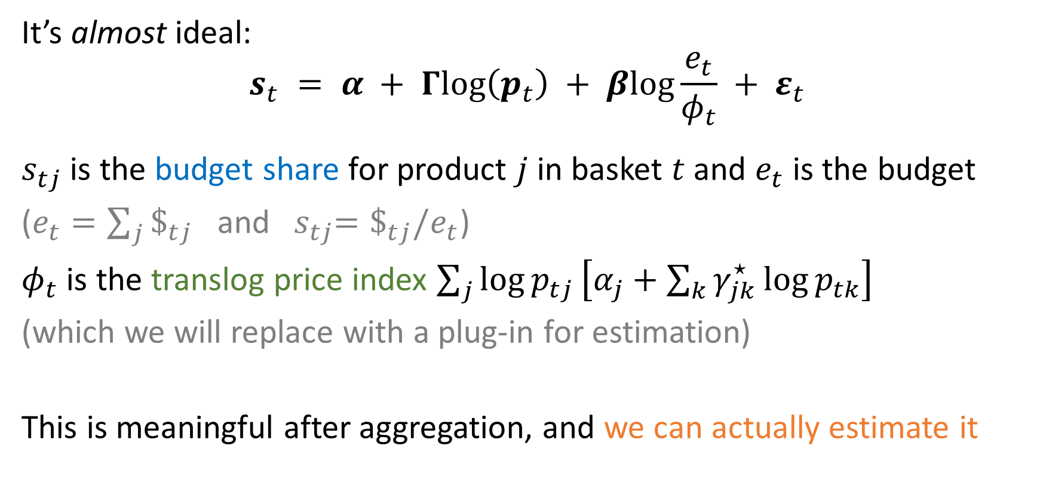
Moving inside a demand system (AIDS)
It’s almost ideal:
$$s_{t} = α + Γlog\left(p_{t}\right) + βlog\frac{e_{t}}{φ_{t}} + ε_{t}$$
$s_{tj}$ is the budget share for product $j$ in basket $t$ and $e_{t}$ is the budget
($e_{t}=\sum_{j}{\$_{tj}}$ and ${ s}_{tj}=\$_{tj}/e_{t}$)
$φ_{t}$ is the translog price index $\sum_{j}{\log{p_{tj}}\left[α_{j}+\sum_{k}{γ_{jk}^{⋆}\log{p_{tk}}}\right]}$
(which we will replace with a plug-in for estimation)
This is meaningful after aggregation, and we can actually estimate it

Slide 9

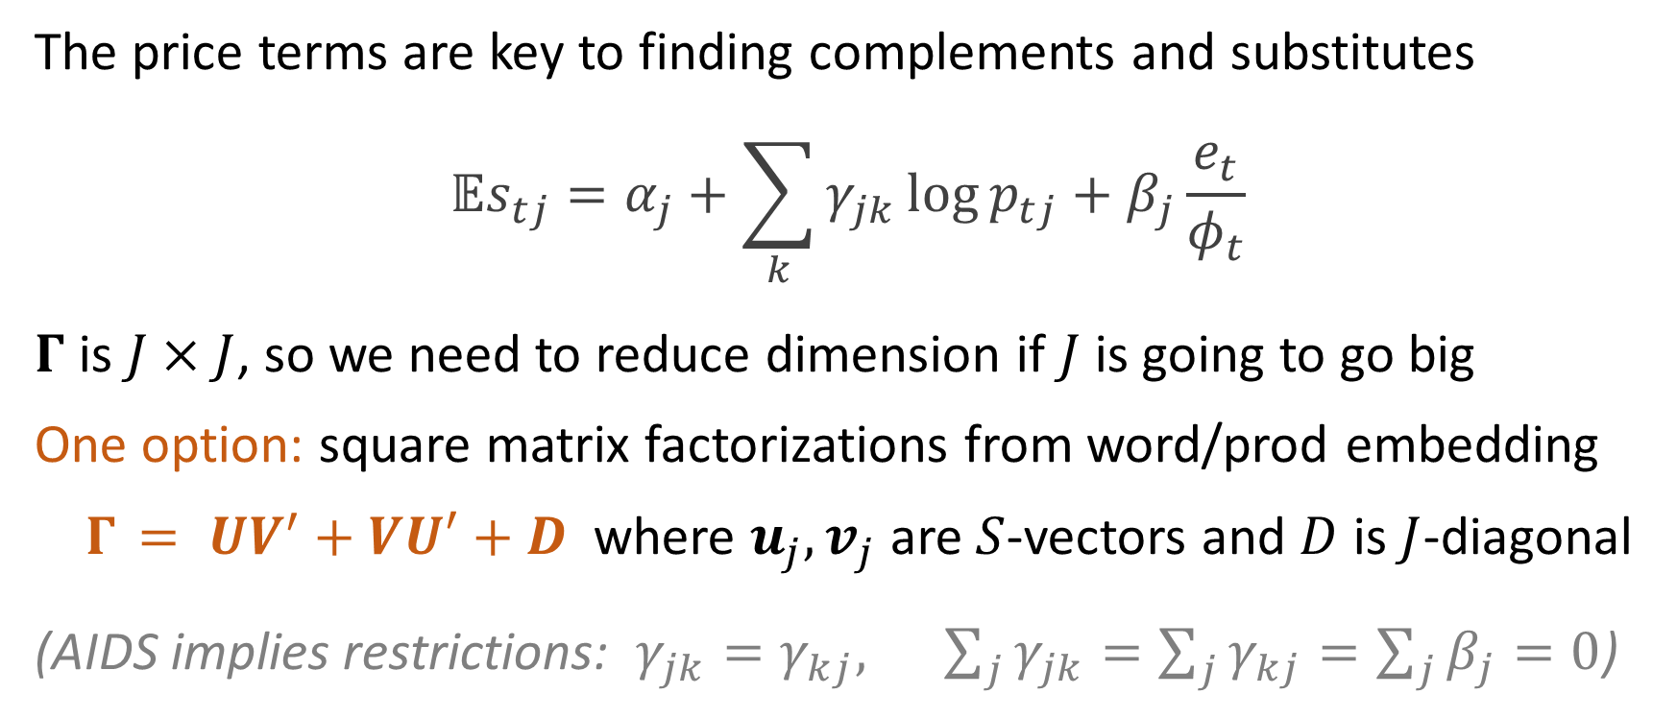
Factorizing $Γ$
The price terms are key to finding complements and substitutes
$${𝔼s}_{tj}=α_{j}+\sum_{k}{γ_{jk}\log{p_{tj}}}+β_{j}\frac{e_{t}}{φ_{t}}$$
$Γ$ is $J×J$, so we need to reduce dimension if $J$ is going to go big
One option: square matrix factorizations from word/prod embedding
$Γ_{ }= UV^{′}+VU′+D$ where $u_{j},v_{j}$ are $S$-vectors and $D$ is $J$-diagonal
(AIDS implies restrictions: $γ_{jk}=γ_{kj}, \sum_{j}{γ_{jk}=\sum_{j}{γ_{kj}}=\sum_{j}{β_{j}=0}}$)

Slide 10
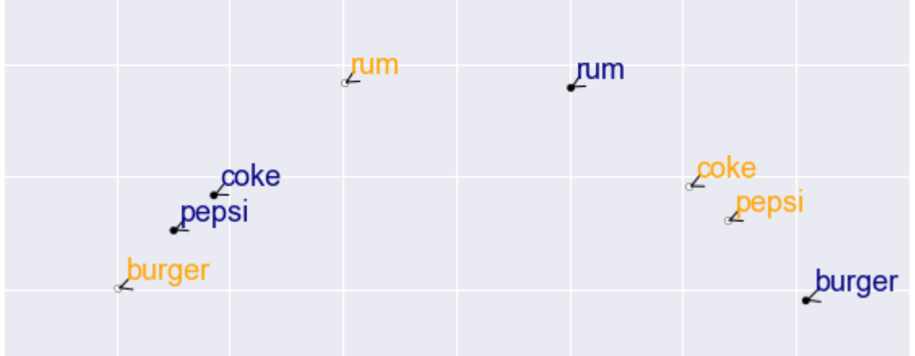
Product Embeddings
substitutes (synonyms) are close in the same vector space
complements (topical words) are close across vector spaces

Slide 11
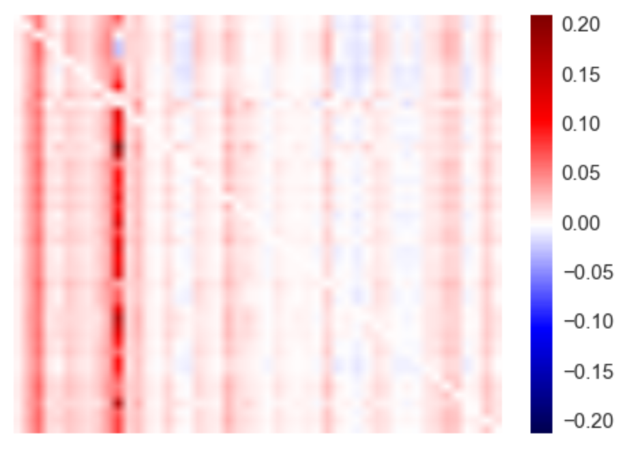



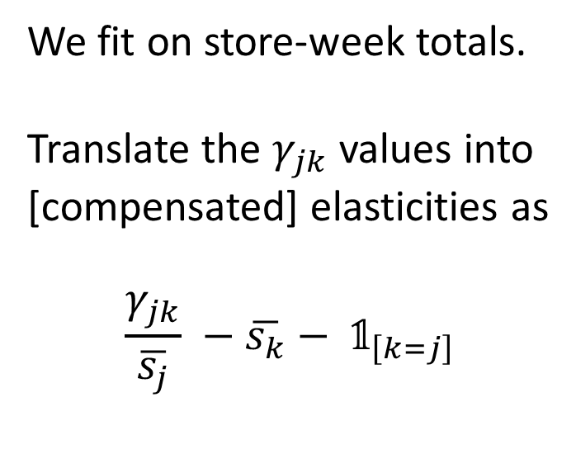
Beer
Elasticity matrix (omitting diagonal)
We fit on store-week totals.
Translate the $γ_{jk}$ values into
[compensated] elasticities as
$$\frac{γ_{jk}}{\overline{s_{j}}} −\overline{s_{k}}− 𝟙_{\left[k=j\right]}$$

Slide 12
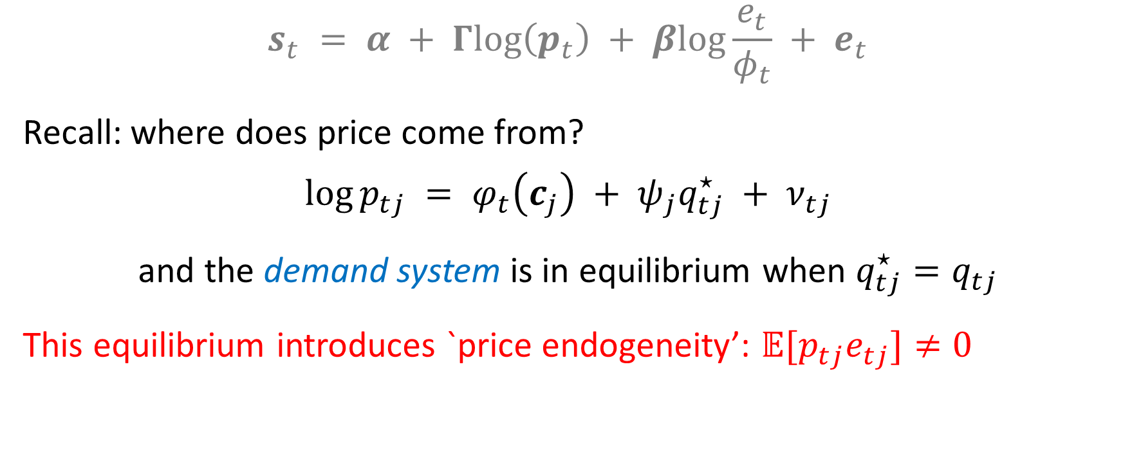
But wait… it’s still a system
$$s_{t} = α + Γlog\left(p_{t}\right) + βlog\frac{e_{t}}{φ_{t}} + e_{t}$$
Recall: where does price come from?
$$\log{p_{tj}} = φ_{t}\left(c_{j}\right) + ψ_{j}q_{tj}^{⋆} + ν_{tj}$$
and the demand system is in equilibrium when $q_{tj}^{⋆}=q_{tj}$
This equilibrium introduces `price endogeneity’: $𝔼[p_{tj}e_{tj}]≠0$

Slide 13
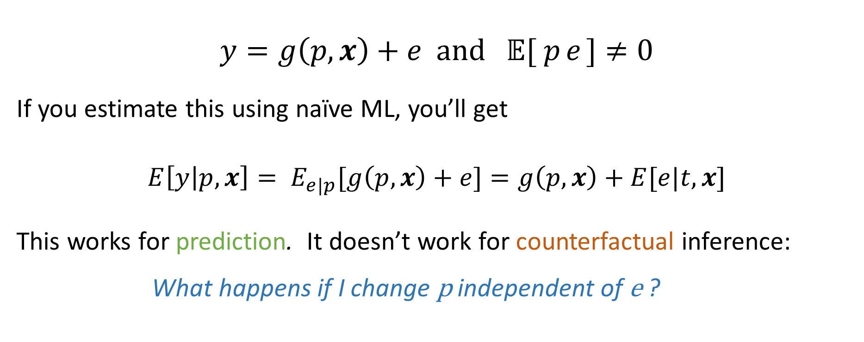
Endogenous Errors
$$y=g\left(p,x\right)+e and 𝔼[{ p}_{ }e_{ }]≠0$$
If you estimate this using naïve ML, you’ll get
$$E\left[y | p,x\right]= E_{e|p}[g\left(p,x\right)+e]=g\left(p,x\right)+E[e|t,x]$$
This works for prediction. It doesn’t work for counterfactual inference:
What happens if I change p independent of e ?

Slide 15
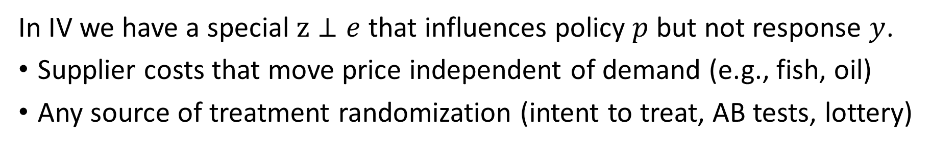
Instrumental Variables (IV)
y
p
x
z
e
In IV we have a special $z⊥e$ that influences policy $p$ but not response $y$.
Supplier costs that move price independent of demand (e.g., fish, oil)
Any source of treatment randomization (intent to treat, AB tests, lottery)

Slide 16
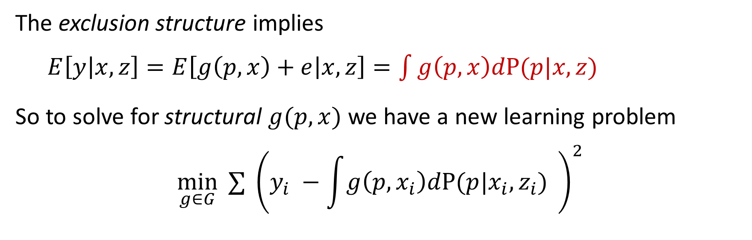
Instrumental Variables (IV)
y
p
x
z
e
The exclusion structure implies
$E\left[y | x,z\right]=E\left[g\left(p,x\right)+e | x,z\right]=\int{g\left(p,x\right)dP(p|x,z)}$
So to solve for structural $g(p,x)$ we have a new learning problem
$$\min_{g∈G}{ ∑} {\left(y_{i} −\int{g\left(p,x_{i}\right)dP(p|x_{i},z_{i})} \right)}^{2}$$

Slide 17
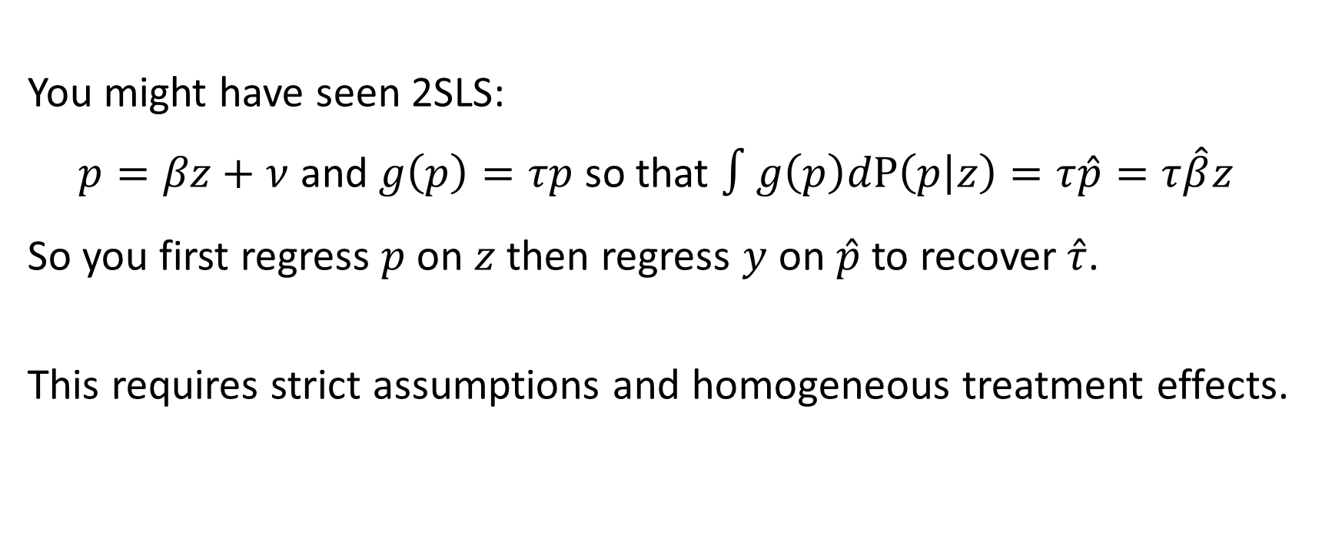

$$\min_{g∈G}{ ∑} {\left(y_{i} −\int{g\left(p,x_{i}\right)dP(p|x_{i},z_{i})} \right)}^{2}$$
You might have seen 2SLS:
$p=βz+ν$ and $g\left(p\right)=τp$ so that $∫g\left(p\right)dP\left(p | z\right)=τ\hat{p}=τ\hat{β}z$
So you first regress $p$ on $z$ then regress $y$ on $\hat{p}$ to recover $\hat{τ}$.
This requires strict assumptions and homogeneous treatment effects.

Slide 18
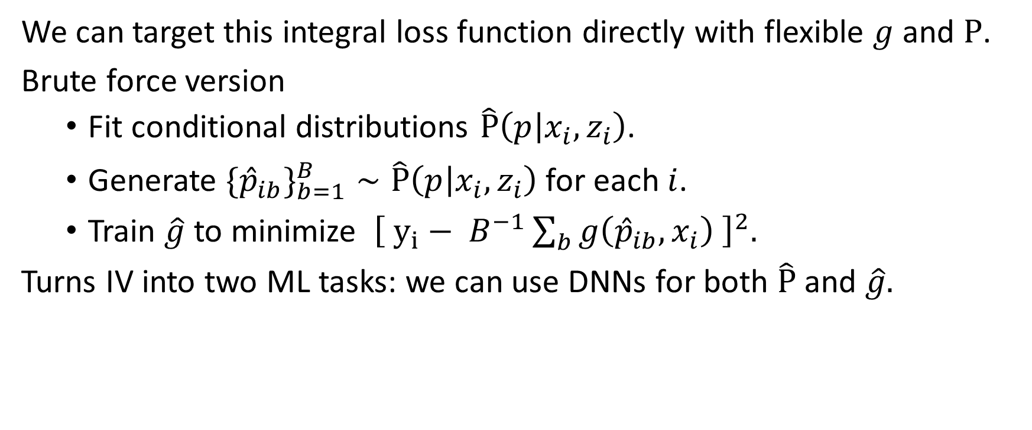

$$\min_{g∈G}{ ∑} {\left(y_{i} −\int{g\left(p,x_{i}\right)dP(p|x_{i},z_{i})} \right)}^{2}$$
We can target this integral loss function directly with flexible $g$ and $P$.
Brute force version
Fit conditional distributions $\hat{P}\left(p | x_{i},z_{i}\right)$.
Generate $\{{\hat{p}}_{ib}\}_{b=1}^{B}∼\hat{P}\left(p | x_{i},z_{i}\right)$for each $i$.
Train $\hat{g}$ to minimize ${\left[ y_{i}− B^{−1}\sum_{b}{g\left({\hat{p}}_{ib},x_{i}\right) }\right]}^{2}.$
Turns IV into two ML tasks: we can use DNNs for both $\hat{P}$ and $\hat{g}.$

Slide 19

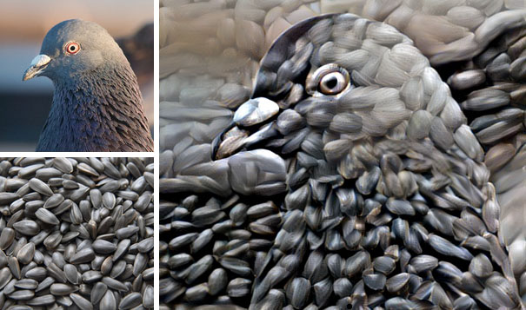
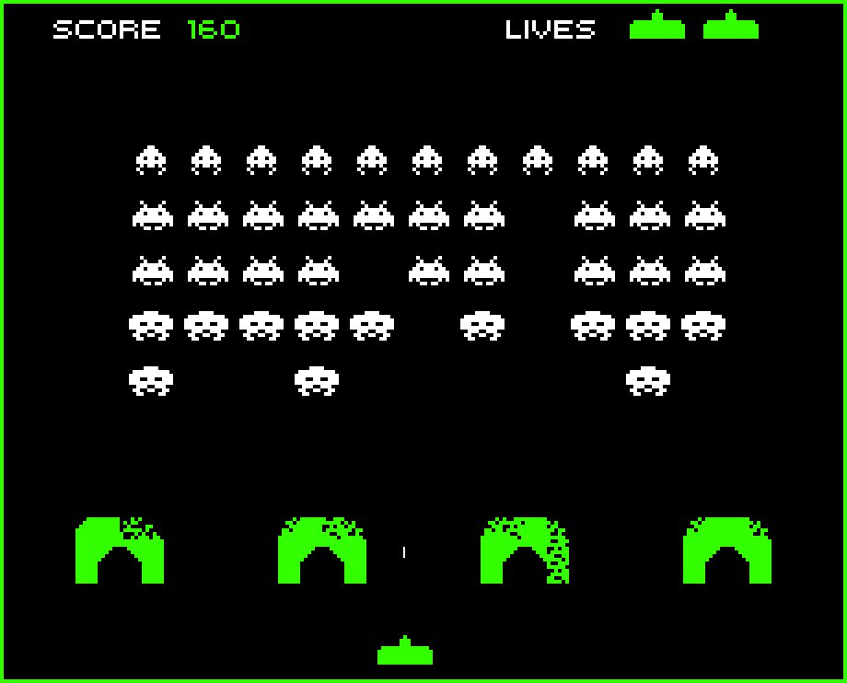
Learning to love Deep Nets

Slide 20
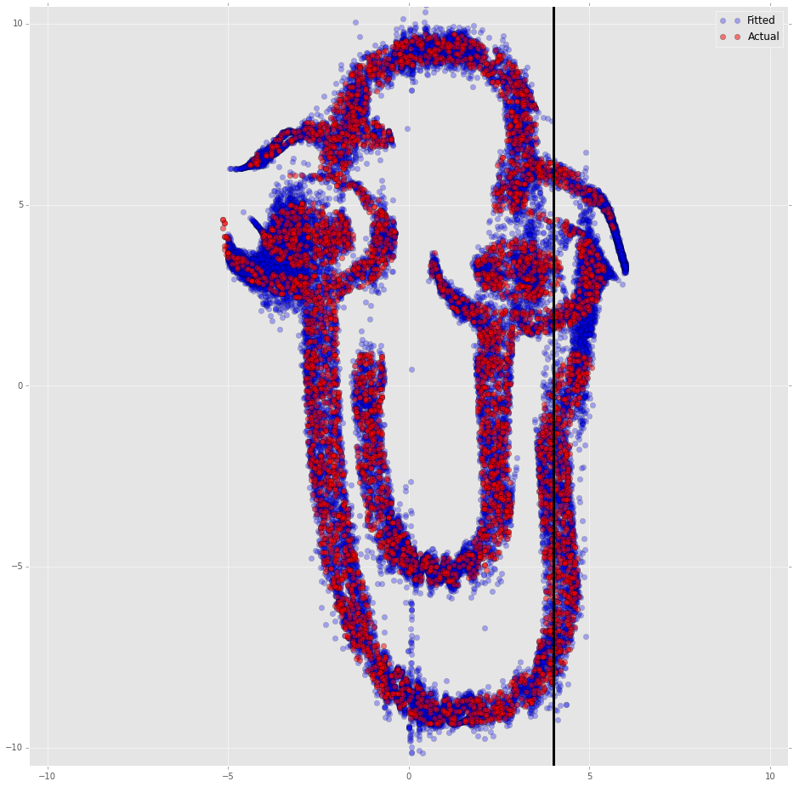
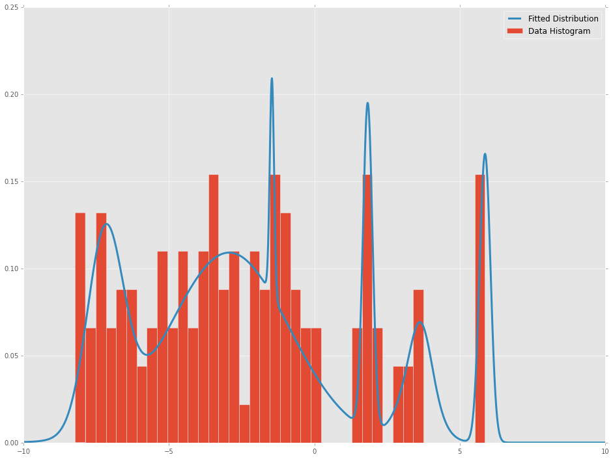

First Stage is out-of-the-box ML: learn $P\left(p | x_{i},z_{i}\right)$
e.g., DNN fits distribution to maximize likelihood for a mixture of Gaussians.

Slide 21
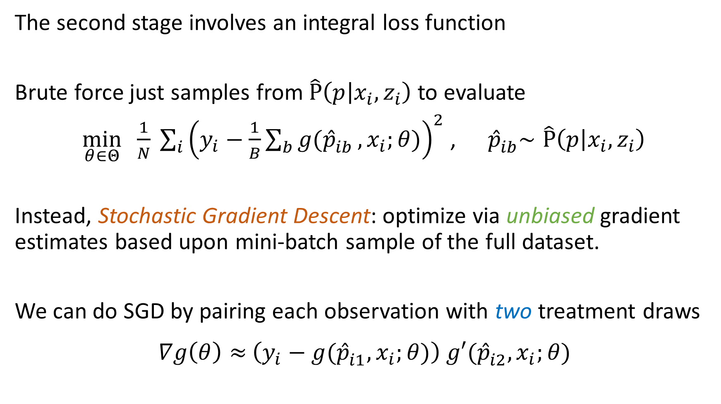
The second stage involves an integral loss function
Brute force just samples from$\hat{P}\left(p | x_{i},z_{i}\right)$ to evaluate
$\min_{θ∈Θ}{ \frac{1}{N} \sum_{i}^{ }{{\left(y_{i}−\frac{1}{B}\sum_{b}{g({\hat{p}}_{ib}^{ }}, x_{i};θ)\right)}^{2}}}$ , ${ \hat{p}}_{ib}^{ }∼\hat{P}\left(p | x_{i},z_{i}\right)$
Instead, Stochastic Gradient Descent: optimize via unbiased gradient estimates based upon mini-batch sample of the full dataset.
We can do SGD by pairing each observation with two treatment draws
$∇g\left(θ\right)≈\left(y_{i}−g({\hat{p}}_{i1}^{ }, x_{i};θ)\right)$ $g′({\hat{p}}_{i2}^{ }, x_{i};θ)$

Slide 22
Linear Demand, Heterogeneous Effects

Slide 23
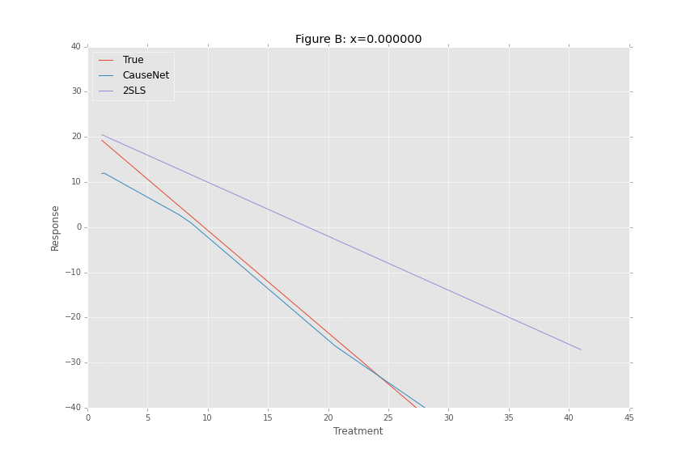
Linear Demand, Heterogeneous Effects

Slide 24
Ads Application
Taken from Goldman and Rao (2014)
We have 74 mil click-rates over 4 hour increments for 10k search terms
Treatment: ad position 1-3
Instrument: background AB testing
Covariates: search text and time

Slide 25
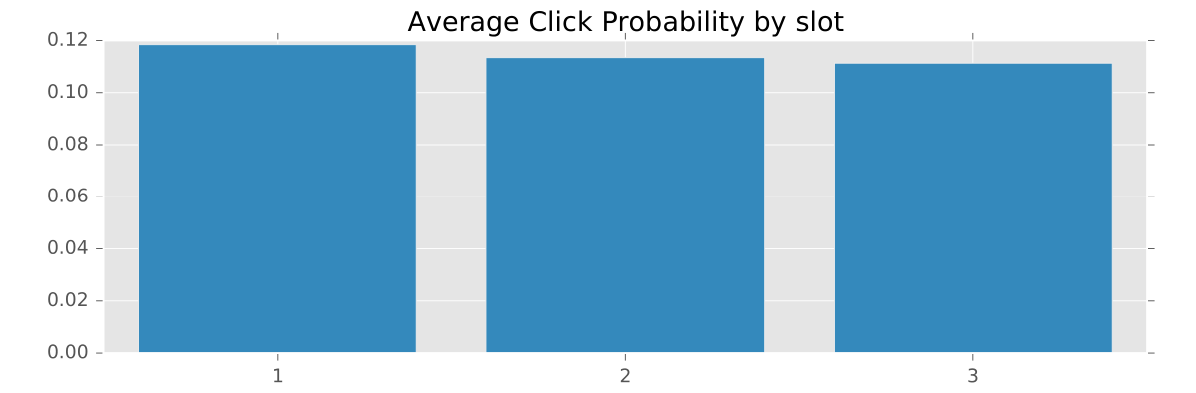
Average Treatment Effects

Slide 26
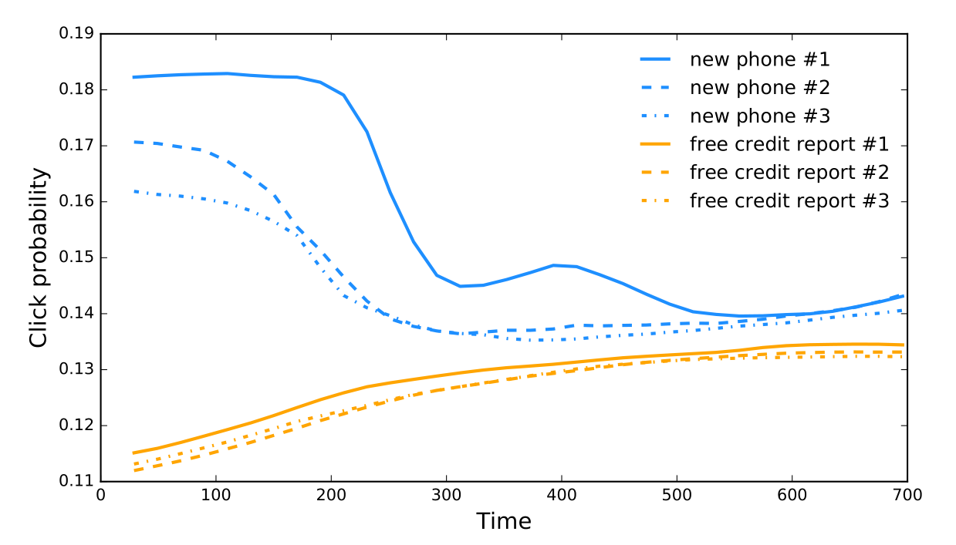
Heterogeneous Treatment Effects

Slide 27
Economics and Artificial Intelligence
We have a track record pointing ML at questions of science + causation.
We’re going to replicate this success at scale on unstructured data
We use economic theory to build systems of tasks that can be
addressed with Deep nets and other state-of-the-art ML.
This is the construction of systems for Artificial Economic Intelligence.

